Slide 1

SHRI SHANKARACHARYA TECHNICAL
CAMPUS, BHILAI (C.G)
MINOR PROJECT
on
“Laptop Price Predictor”
Divya Pawar (301402220038)
Naman Baveja (301402220083)
Rahul Singhal (301402220103)
Presented by :-
Guided by :-
Prof. Abha Choubey

Slide 2
CONTENTS:-
Introduction
Hardware & Software Requirement
Methodology
Result
Future Scope

Slide 3
Introduction:-
The Laptop Price Predictor is a machine learning-based system designed to estimate the price of laptops based on their specifications. This project aims to address this issue by leveraging historical laptop data and employing advanced algorithms to create a predictive model.

Slide 4
Hardware And Software Requirements:-
Software requirement: -
Python
IDEs
Data preprocessing and visualization libraries
Colab notebooks
Git

Slide 5
Hardware And Software Requirements:-
Hardware requirement: -
Processor
RAM
Graphic Processing Unit

Slide 6
Methodology:-
Data Collection and Pre-processing: The first step in the project methodology involves collecting a dataset containing information about various laptop models, including their specifications (such as processor type, RAM, storage capacity, display size, and brand) and their corresponding prices.

Slide 7
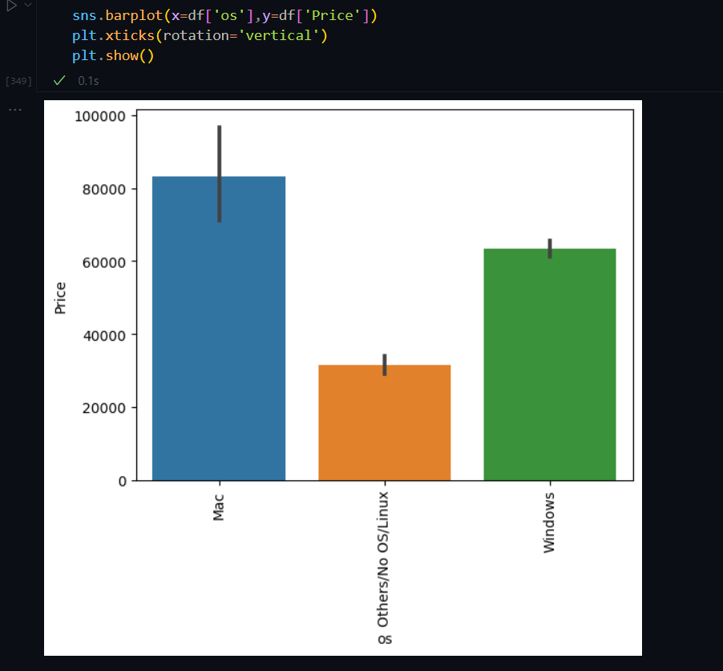
Methodology:-

Slide 8
Methodology:-
Model Development and Training: After pre-processing the data, the next phase focuses on model development and training. Different machine learning algorithms, such as linear regression, decision trees, and random forests, are employed to train a predictive model.

Slide 9
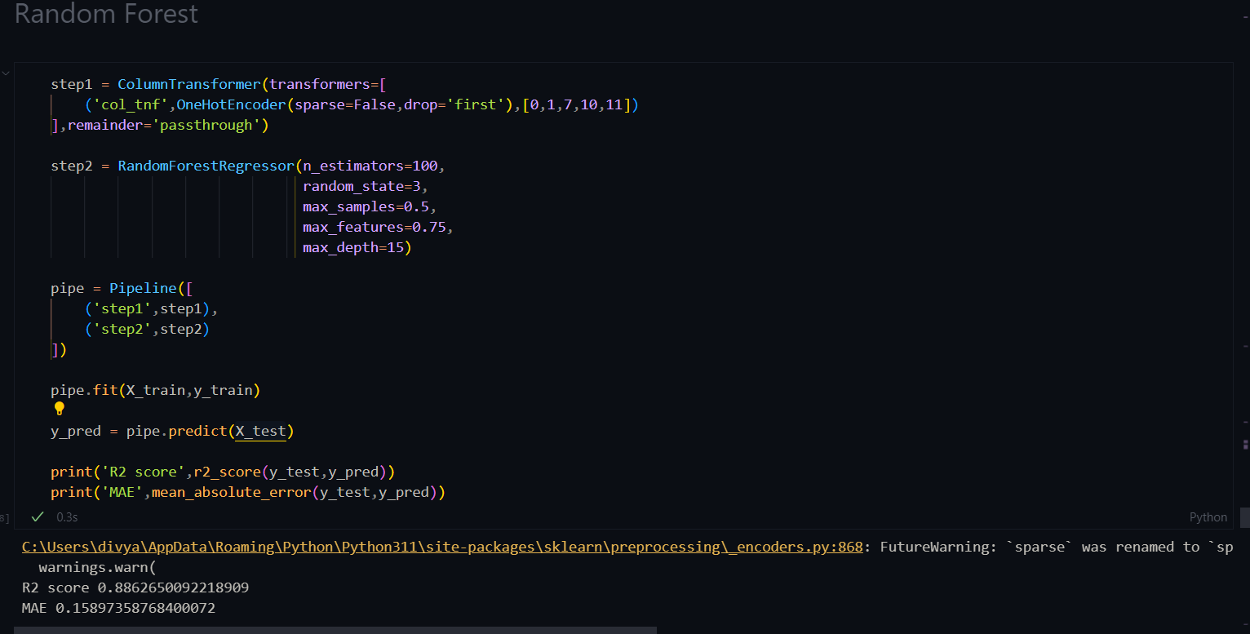
Methodology:-

Slide 10
Methodology:-
Prediction and Deployment: Once the model is trained and evaluated, it is ready for prediction and deployment. A user interface is developed where users can input the specifications of a laptop they are interested in, and the trained model generates an estimated price based on those specifications is calculated

Slide 11
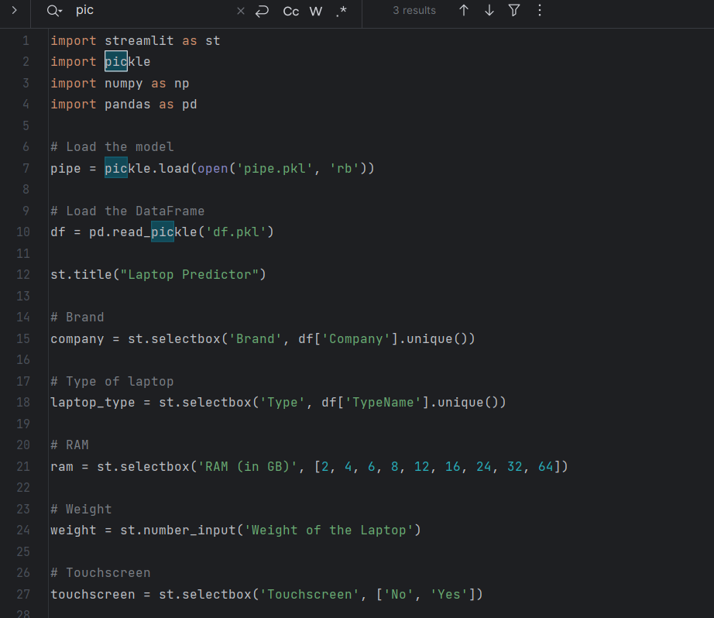
Methodology:-

Slide 12
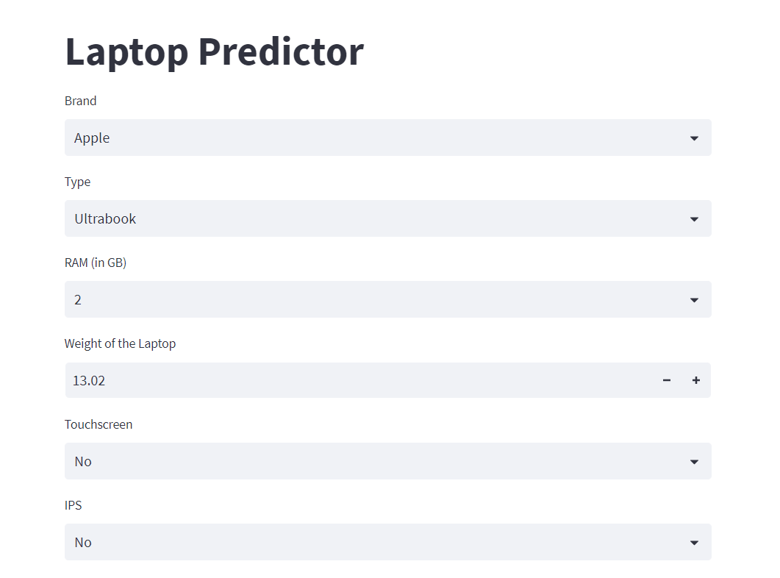
Results

Slide 13
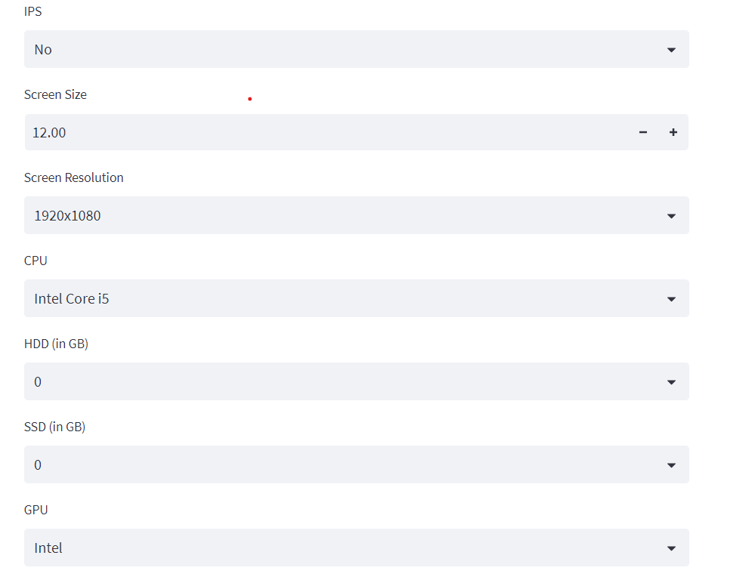
Results

Slide 14
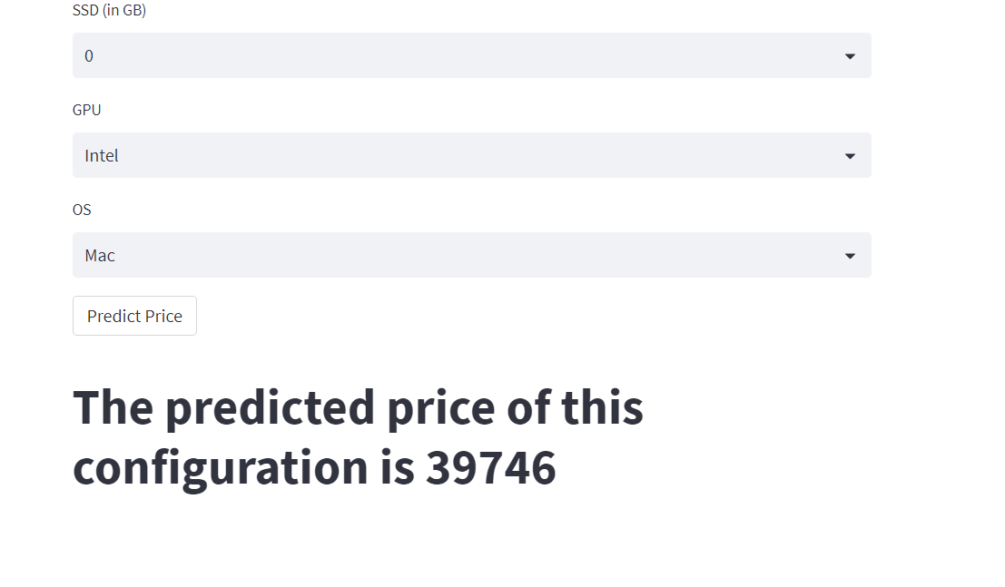
Results

Slide 15
Conclusion
In conclusion, the Laptop Price Predictor project has successfully developed a machine learning model that can estimate the price of laptops based on their specifications. By leveraging historical data and employing various pre-processing techniques, the project has created a valuable tool for both consumers and retailers.
The project has demonstrated the effectiveness of machine learning in addressing the challenge of determining fair market value in the laptop industry. With the potential for future advancements such as model enhancements, integration of external data sources, and expansion into other electronic devices.

Slide 16
THANK YOU

